Slide 1
Diversify Your Assets-The When And Why Of Using New Technologies

Slide 2
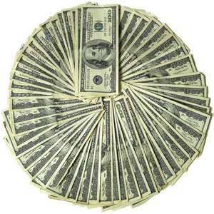
The plan
Figure out why the U pays you
Figure out what can make you worth mo’ money
Examine ways to find out about new technologies
Examine ways to decide what new technology is worth learning
Examine some current tools and how to use then
Telerik ASP.NET controls
RedGate’s Tricks
WebAuth by cB
QuickWeb by me

Slide 3

3 rules for dating my IDE
Good software design is making good decisions so your user can't make bad decisions.
Last Week
Tackle a difficult problem by redefining it as a series of solved problems.
This week and next week-SubSonic and LINQ
Only test the scenarios you want to work in production.
Future workshop

Slide 4

What is your value?
Programmers are a capital asset
We make things so people take less time and are more accurate
The faster and more accurate we make things, the more we are worth

Slide 5
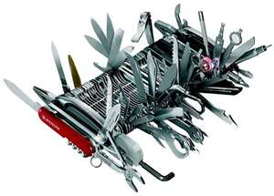
So to be worth mo’ money→
We use tools that make us faster and more accurate
We make tools to make us faster and more accurate

Slide 6

Capital Assets 101
Capital assets are things that are worth less every day
Think about a car as an asset
It is worth less every day-Depreciates
Your toolbox of tricks is your capital account

Slide 7
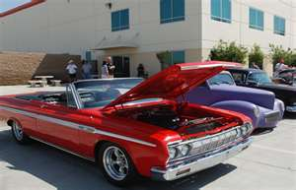
Turn some trickz
If you don’t invest in new tricks, your knowledge depreciates
One odd exception-Antiques
Due to scarcity and demand-some old things regain worth after being depreciated
Classic cars

Slide 8

Example
ASP (not .NET)
You can code anything in ASP that you can in .NET
The difference is in speed and accuracy
Remember the faster you work the more you are worth
Note Antiques market for asp apps
D2L
Bookstore application

Slide 9

It’s your bid-ness
Business Model
Diversify your assets into a cash flow and keeping some capital reserves for future profits
What you can program now is your cash flow
What you learn to program faster in the future are your capital assets

Slide 10
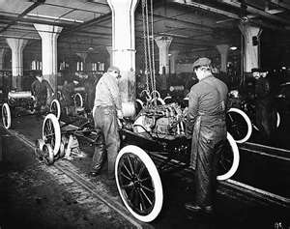
If you just program what you know—
You don’t take advantage of new methods
Like a business that spends all of its profits
Capital Assets depreciate
You fall behind to others who adapt new technologies
Think assembly language example…
Program to level of detail required
Garbage collection as example

Slide 11
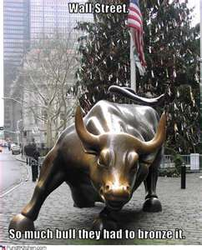
If you just learn new technologies—
You don’t get anything done
Liquidity crisis like Merrill Lynch

Slide 12

Where’s Waldo?
Get a lifeline of places to find out about new technologies
ASP.NET –Microsoft’s site
Code Project
Red Gate
Telerik.Com -because we have it already
Extension Manager in Visual Studio

Slide 13

Learning Style-Know Thyself
How do you learn?
Videos
Example Code
Books
Should always read code

Slide 14

What to think about
Evaluate the technology
Is there one place that I can use this in a project now and many future projects?
Does this allow me to do something I can’t do now?
Learn the most promising technology

Slide 15
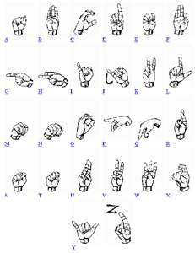
A quick aside on languages
My 2 Cents
Languages mostly do the same things
Some languages make things easier to code
Exotic languages that allow you to do something you can already do don’t make you worth more money to the U
Should concentrate on APIs

Slide 16


API
What is an API?
I want to program something but don’t care about the details
Lots of API on the web
Google
Amazon

Slide 17

Let’s Get it started…Pimp My IDE
Start with the Extension Manager and Home Page
Built into Visual Studio
Lots of extensions to save time by eliminating chores
If I do Y after X, then when I do X, Y should happen
http://gringoagave.blogspot.com/2010/03/what-is-good-software.html
Lots of stuff for cleaning up your code
Clean code is better, always
Always do one at a time!

Slide 18

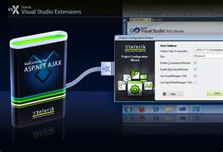
SSAG has your back
Red Gate
Telerik
WebAuth

Slide 19

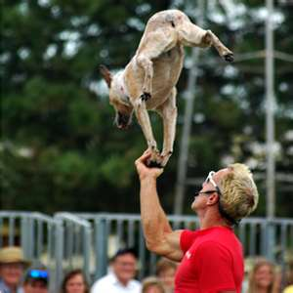
Red Gate Tips
SQL Search- ALWAYS use it
SQL Prompt Query Window Tricks
Code in New Query Window for Intelligence

Slide 20

For the DBA who forgets everything
Use the star trick
Inner join wizard
Pull up the suggestions dialog
Examine table with right click
Column Picker
Qualify names
Snippets
Fun ones!
Create you own

Slide 21

You look mav-a-lus
Set your options
Make your code pretty CntrlK-CntrlY
Find invalid objects
Move views to new query window
Design Graphically
Tag your inserts
Refresh=Cntl-Shft-D

Slide 22

Telerik
A couple of items you should be using
RadGrid
RadComboBox
RadAjaxManager/ScriptManager
RadTabs
RadDate Controls
Scheduler-needed

Slide 23
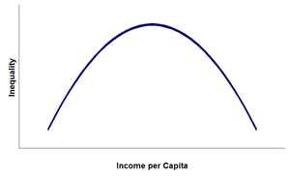
Be ahead of the curve
Get the latest version
More success if you download instead of wizard
There are ALWAYS improvements with each new version
CDN if possible

Slide 24
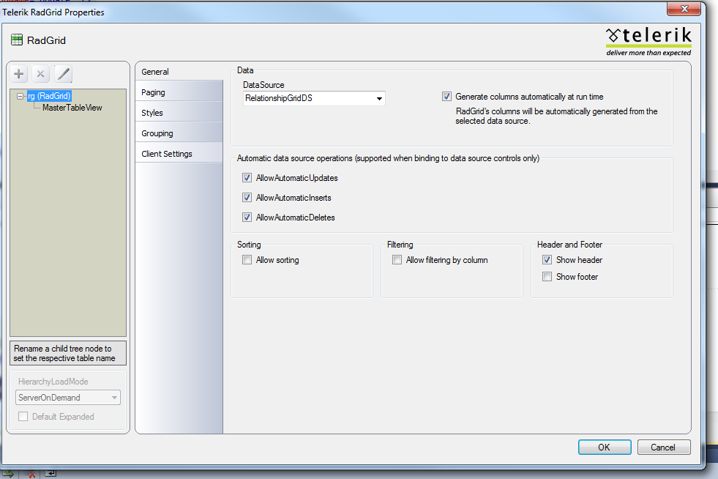

Slide 25
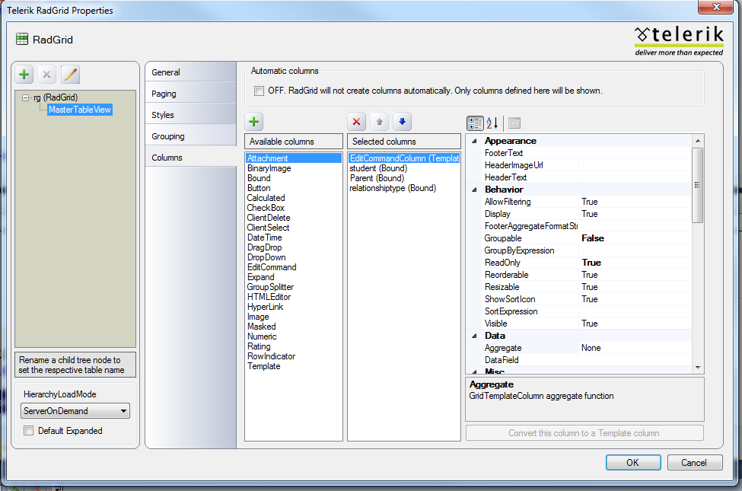

Slide 26
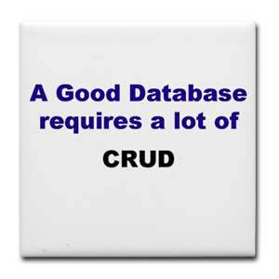
RadGrid
Hook it up to a raw table
Don’t forget to allow sql CRUD
3 methods for edit pages
Make it styling
Don’t forget the scriptmanger and radmanager

Slide 27
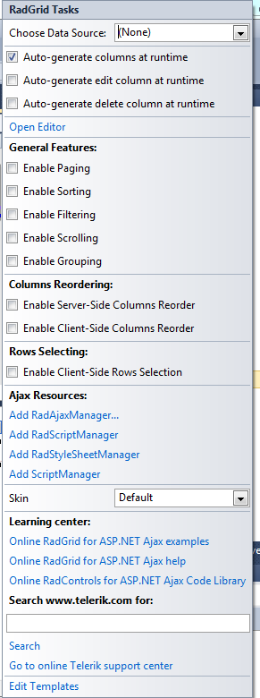
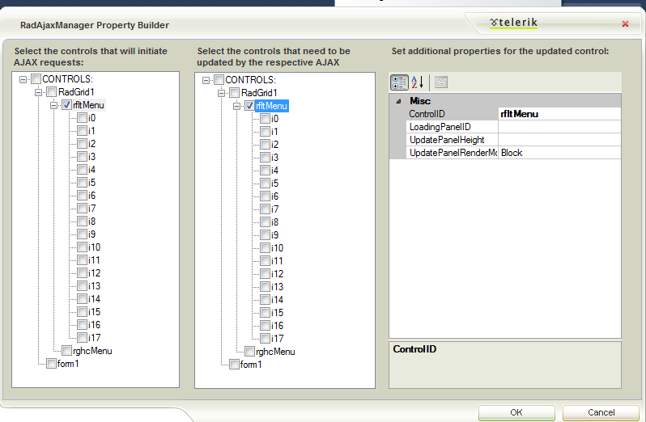
RadAjaxManager/ScriptManager
Ajax makes life better for the user
Ajax means no response objects
Only update what you want

Slide 28
FNT-Frequently Needed Tricks
Don’t allow to user to change column
Bound –readonly=“true”
Don’t show users all columns in list but needed in edit
Bound-Visible=false
Link to another page with id
Hyperlink –
DataFormatString=“pagename.aspx?id={0}&name={1}
DataFields=“id,name”

Slide 29
More FNTs
I have lookup tables attached to the table
Dropdown- Use Datasource
I need something special with one column
Template
I need an add button
InsertItemPageIndexAction="ShowItemOnCurrentPage“
CommandItemDisplay="TopAndBottom"
CommandItemSettings-AddNewRecordText="Add Page“
I need filter/paging
Just a click away
Grouping-> case sensitive

Slide 30

FAP-Frequent Annoying Problems
Doesn’t update
Allowupdates=true
Names must match sp if SQL DataSource
DataKey always is sent
Sometimes easier to just start over

Slide 31
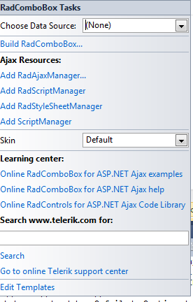
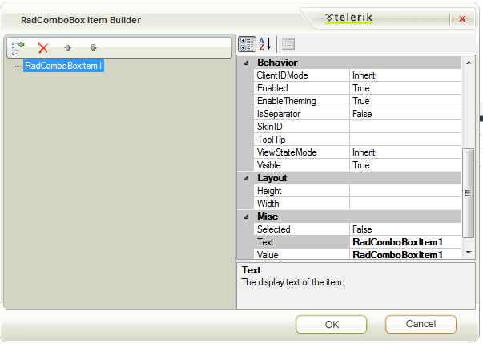
RadComboBox
A better dropdown

Slide 32
USFRCB-Useful settings for RadComboBox
Filter="Contains“
Width="300px"
AutoPostBack="true"
MarkFirstMatch="true"
onselectedindexchanged="cbo1_SelectedIndexChanged"
AppendDataBoundItems="true"
EnableItemCaching="true"
EnableAutomaticLoadOnDemand="true"

Slide 33

RadTabs
Quick and easy menus
Multipage to get one page
Beware of large pages
Use Iframes

Slide 34
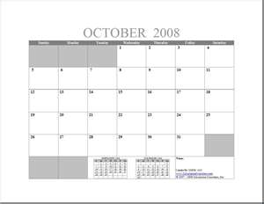
RadDate Controls
RadDateTime
InputManager
TimePicker
MonthPicker

Slide 35
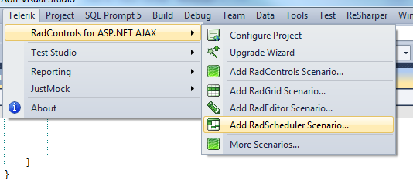
Rad Scheduler
Wizard

Slide 36
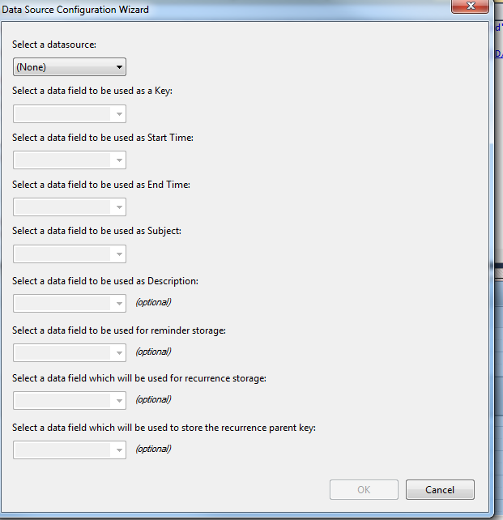
Better wizard with right-click

Slide 37
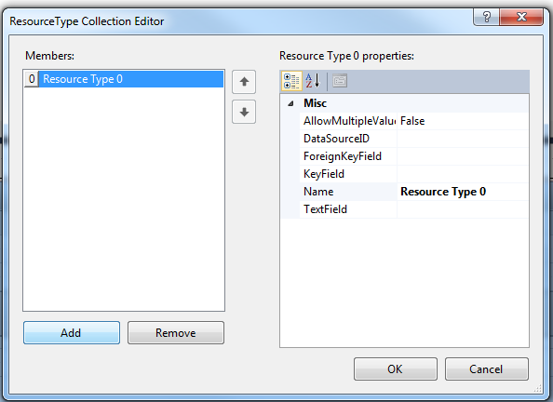
Resources management built in

Slide 38
Controls from EMSG Namespace
WebAuth
Use it don’t roll your own
QuickWeb
My annoyances with indexes that should be methods
DLLs and subversion and Visual Studio
Check in dlls without source code

Slide 39
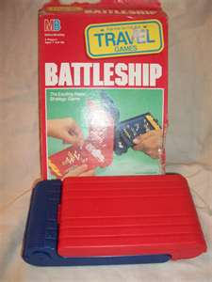
T4-You sunk my battleship
T4 templates
Since VS 2008
SubSonic uses them
Can intellisense via Extension Manager download!
You can make code to make code

Slide 40

Roll your own
When do I make a tool to do a job?
Did I have to do this before?
Can I reduce customer contact?
If a customer asks you to do a manual process twice, make an app to accomplish the task

Slide 41
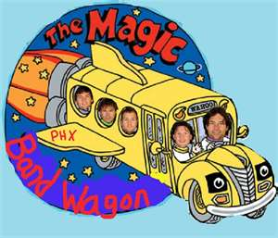
Make it dll-icsious if useful
You got a good dll
Then make it an API
Join the API bandwagon

Slide 42
So in summary
Look for ways to improve your time to market and efficiency
Determine the most impact items and use them
Use the tools we already have
Learn a little more each day

